Slide 1

Memory Hierarchy (part I)
Alexander Titov
14 February 2015

Slide 2
Refresher: Pipeline limitations
Max speed of the pipeline is one instruction per clock
It is rare achievable in in-order processors due to dependencies among instructions and long latency operations
Load from the memory
F | D | E | M | W
 | F | D | E | M | W
 |  | F | D | E | M | W
M | W
 |  |  | F | D | E | M | W
 |  |  |  | F | D | E | M | W
 |  |  |  |  | F | D | E | M | W
F | Stall
D | E | M | W
F | D | E | M | W
 | F | D | E | M | W

Slide 3
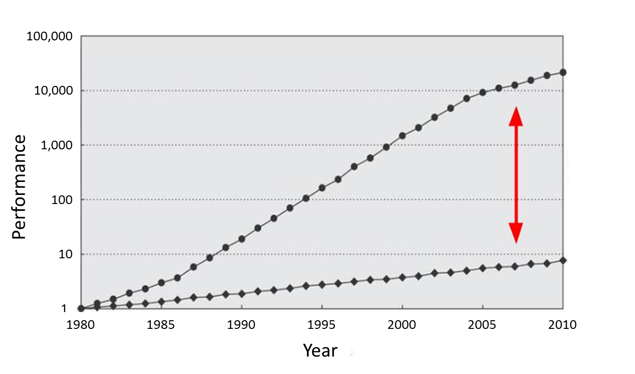
Memory Is Slow
CPU
60% per year
(Doubles every 1.5 year)
Performance gap
9% per year
(Doubles every 10 year)
DRAM

Slide 4
Memory Hierarchy
Main memory is large, but too slow
Small memory is fast, but cannot hold all required data
Solution: take the best of both and combine
Memory hierarchy provides visibility that memory is usually fast
L3
Cache
Main Memory
L1
L2
CPU
smallest, but fastest
slowest, but largest

Slide 5
Why Does It Work?
Temporal Locality (Locality in Time):
If an item is accessed, it will tend to be accessed again soon
Example: code and variables in loops
→ Keep recently accessed data closer to the processor
Spatial Locality (Locality in Space):
If an item is accessed, nearby items tend to be accessed soon
Example: scanning an array
→ Move contiguous blocks closer to the processor
Locality + smaller HW is faster memory → hierarchy

Slide 6
Cache: Main Idea
The cache holds a small part of the entire memory
Need to map parts of the memory into the cache
Main memory is virtually partitioned into lines
Typical block size is 32 to 64 bytes
Blocks are aligned
Memory
#line
0
1
2
3
4
5
6
…
…
91
92
93
…
…
The cache holds data by lines
Only a subset of the blocks is mapped to the cache at a given time
Address of lines is used as a key
Cache
#line
2
91
4
5

Slide 7
Cache Lookup
Case 1: Cache Hit
The requested line is in the cache
The cache returns the requested line (fast)
Case 2: Cache Miss
Memory
line#
0
1
2
3
4
5
6
…
…
91
92
93
…
…
Cache
line#
2
91
5
hit
4
4?
CPU

Slide 8
Cache Lookup
Case 1: Cache Hit
The requested line is in the cache
The cache returns the requested line (fast)
Case 2: Cache Miss
The requested line is not in the cache
Need to fetch it from the main memory (slow) and fill the cache
May need to evict another line from the cache to free space for the new one
Memory
line#
0
1
2
3
4
5
6
…
…
91
92
93
…
…
Cache
line#
91
5
2
93
miss
93?
4
93?
CPU

Slide 9
Fully Associative Cache
Line may be mapped to any cache entry
Lookup line in all entries
Address is partitioned to
Offset within a line (byte#)
Line # (so-called tag)
Each cache entry has a tag
All tags are compared to the line# in parallel
If one of the tags matches the line#, we have a hit
Address
64 | 5 | 0
Tag = line# | Offset
Tag
Array
Data
Array
63
0
0
1
…
511
=
=
…
…
=
…
hit/miss
data

Slide 10
Direct Mapped Cache
Line is mapped to the fixed entry only
Lookup line in one entry
Address is partitioned to
Offset within a line (byte #)
Set (fixed cache entry #)
Tag (works as a key)
Conflicts are possible
If several lines are mapped to the same entry, only one can reside in the cache
Address
64 | 14 |  | 5 | 0
Tag | Set |  | Offset
Data
Array
Tag Array
set#
63
0
0
1
…
511
…
=
hit/miss
data

Slide 11
Memory Layout: Direct Mapped Cache
Memory is virtually partitioned
into lines
line size = 2 ^ offset_size
lines grouped into slices
# of lines in slices = 2 ^ set_size
slice size = # of lines in slice * line_size = cache size
slice # = tag value
line # inside a slice = set value
64
0
 | Offset
 | Set | Offset
Tag | Set | Offset
Memory Space
set#
cache size
set#
cache size
tag#
Mapped to the same set
set#
cache size
…
Disadvantage is line evictions due to set conflicts
set#
cache size

Slide 12
2-Way Set Associative Cache
Conflicts are harmful → multi-ways cache is a solution
Each set holds two entries (way 0 and way 1)
Each line can be mapped into one of two entries in the appropriate set
Address
64 | 13 |  | 5 | 0
Tag | Set |  | Offset
way #0
way #1
Tag Array
Data Array
Tag Array
Data Array
set#
63
0
set#
63
0
0
1
…
255
0
1
…
255

Slide 13
2-Way Set Associative Cache
Address
64 | 13 |  | 5 | 0
Tag | Set |  | Offset
Tag Array
Data Array
way #0
way #1
way #0
way #1
set#
set#
63
0
63
0
0
1
…
255
0
1
…
255
=
=
MUX
hit/miss
data

Slide 14
Memory Layout: Multi-Way Cache
Memory is virtually partitioned almost the same as in direct map cache
The only difference is slice size
slice size = cache size / # of ways
Compared to direct map cache
Decrease slice size → increase # of slices → increase # of lines mapped to the same set
But in each set we can have multiple lines (= # of ways) at a given time
Example: 32KB, 8 ways, 64B line
Memory Space
set#
way size
Mapped to the same set
…
address
way size = 32KB / 8 = 4KB
# of sets = 4KB / 64B = 64
64 | 11 |  | 5 | 0
Tag | Set |  | Offset

Slide 15
Cache Performance
Terms:
Miss Rate = Misses / total CPU request
Hit Rate = Hits / total CPU request = 1 – Miss Rate
Cache goal is decreasing average memory access time (AMAT)
AMAT = Hit Rate * Hit Time + Miss Rate * Miss Penalty
Example:
HitRate ≈ 0.9, HitTime ≈ 4 clk, MissRate ≈ 0.1,
MissPenalty ≈ 200 clk, then…
AMAT = 0.9 * 4 + 0.1 * 200 = 23.6 clk
AMAT w/o cache = 200 clk
About 10x improve!

Slide 16
End of Part I

